Slide 1
IF ELSE IF LADDER
The C if statements are executed from the top down. As soon as one of the conditions controlling the if is true, the statement associated with that if is executed, and the rest of the C else-if ladder is bypassed. If none of the conditions are true, then the final else statement will be executed.

Slide 2
IF ELSE IF LADDER
if (condition)
// statement;
else if (condition)
// statement;
else
// statement;

Slide 3
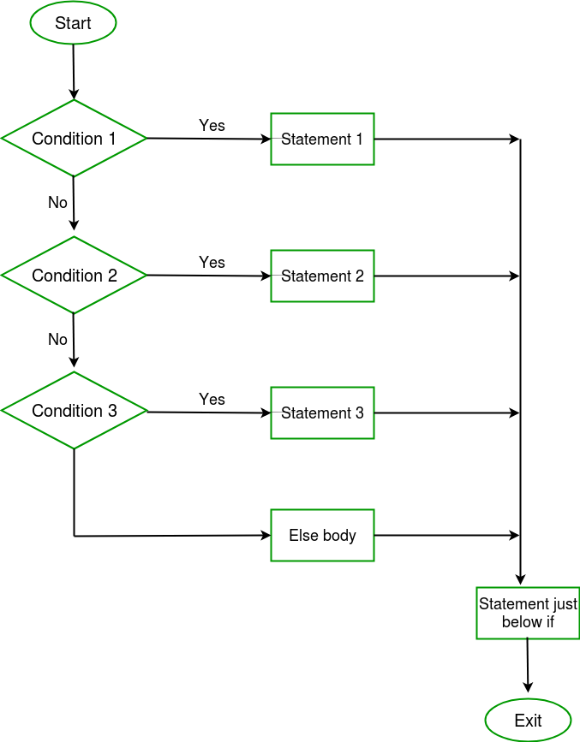
IF ELSE IF LADDER FLOWCHART

